Slide 1
The API Economy and Cast Iron Web API Andrew Daniel – Cast Iron UI Developer
Andrew Daniel – Cast Iron Web API Software Engineer
21st March 2013
Notes:
Introduction to the API Economy
- Introduce matt – senior software engineer in cast iron

Slide 2
Agenda
IBM Presentation Template Full Version
What is API Management?
The API Economy
The Engaging Enterprise
The Basics of Web API
Web API key concepts
Web API Demo
Source If Applicable

Slide 3
What is API Management?
5.9 Billion
Mobile
Subscribers
Globally
in 2011
The API Economy
400 Million Tweets Per day, with 10x more traffic via Twitter API
#HeavyUsage
$7bn worth of items
sold annually on
eBay through APIs
25 Billion Apps downloaded from the Apple AppStore
Over 1 Billion API calls per day each from Netflix, eBay Klout & AccuWeather
3
IBM Confidential
Notes:
*Why is this a good idea, why should they use APIs*
What is the API Economy? It’s the current stage of evolution in the space,
It started…A typical evolution of a web store started as a physical store –
Then phone orders – static website – ecommerce – API’s
Shopping consumer experiences
eBay once was a thriving auction site, now sells through it’s APIs
? Think about services you can provide through APIs, to compete

Slide 4
The Engaging Enterprise
Business Users want to engage Customers in new markets
They need to Externalize the Enterprise
They need to get Apps in front of these Customers
Apps need APIs that Externalize the Enterprise
App Developers use APIs
App Developers are now External to the Enterprise
IT Guys need to secure, scale and support the externalized Enterprise
Business Users and IT Guys needs Insights so they can respond to business needs
Apps
Customer
Business User
Enterprise
IT Guy
App Developer
The Platform
Enterprises wants to tap into innovation from a large community of developers, not just developers they employ
Notes:
*Focus > Personas > The end to end process*
Business user drives the conversation, the IT guy can push and develop the APIs – Externalise the Enterprise
They alter their current systems or add a new view, or layer for the app developers
App developers may be internal, sub contractors or some guy creating apps at home
App developers provide the interface on top of the api in the form of an app of some kind to customers
Circle = Business services
Business users use Analytics for insights into past trends, who made the calls, what device
What percentage of the past 30 days of usage came from iPhones?

Slide 5
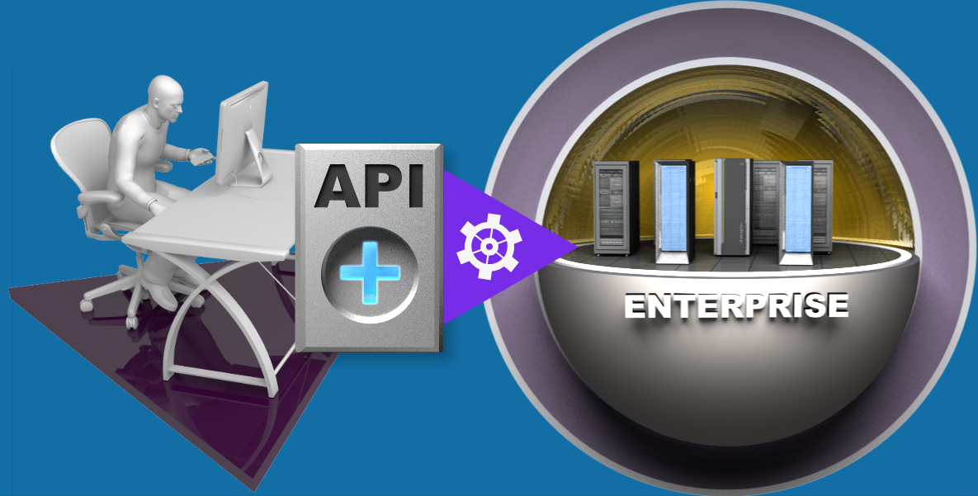
The Basics of Web API
A web API is a public persona for an enterprise; exposing defined assets, data or services for public consumption
A web API is simple for app developers to use, access and understand
A web API can be easily invoked via a browser, mobile device, etc
What Value Does a Web API Provide?
Extends an enterprise and opens new markets by allowing external app developers to easily leverage, publicize and/or aggregate a company’s assets for broad-based consumption
What “assets, data or services” are exposed via a Web API?
Product catalogs
Phone listings
Insurance cases
Order status
Bank loan rates
… anything!
2. Builds
Notes:
APIs are simple and public. Not like Web Services
Core services that you want to keep internal, like bank transfers, keep as a trusted thing
Other business information is appropriate to share, like ATMs, Kiosks, Government of Open Data

Slide 6
Key Concepts
Security
Managing access
Quota usage, tracking and monitoring
Capability
Proxy of existing services
“Assembly” of existing data sources to create a new API
Caching
Deal with increased load on backend services
Flood control / DoS prevention
Analytics
Technical metrics about calls made, devices used, workload per app developer
Business level queries defined on the fly
Community
Publicize and promote adoption of your APIs
Manage sign up of app developers
Provide branding for your enterprise, plus self service documentation and samples for your users

Slide 7
Demo
Demo of IBM Cast Iron Web API
webapi.castiron.com

